Slide 2
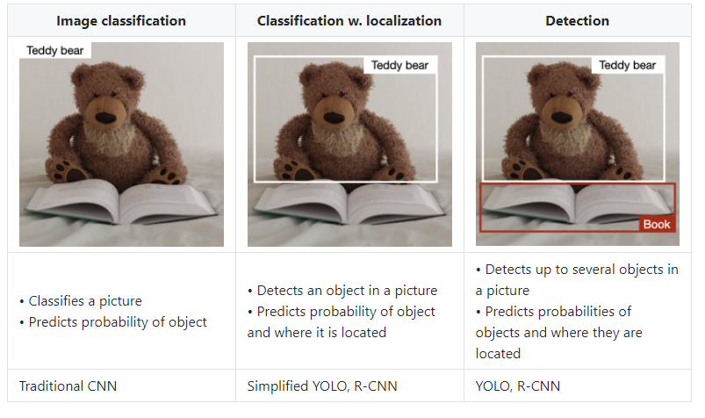
Advanced CNN Usage
Key Task of CNN:
Our previous task was the classification of a picture, but there are more tasks, where they can be used!

Slide 3
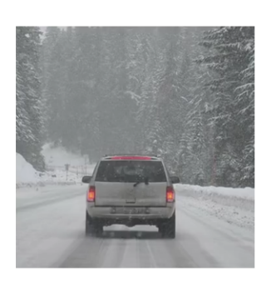
Image Localization & Detection Bounding Box Prediction
Receptive field of the network
Detects the area of the image where the object is located. We have previously seen the use of GradCAM as an object detector.
Focus on e.g.
Tire & Backlighting
0.65
0.8
0.9
0.95
0.8
0.94
0.99
0.8
The naïve approach would be a fixed size box (yellow) sliding over the image and predicting class or no class
We would end up with a large set of possible bounding boxes (red).
We can use non maximum suppression to use only the bounding box with the highest class probability to detect our correct bounding box
Problem: Bounding Box size is fixed and class localization can be wrong because we focus on the features maximizing our class probability

Slide 4
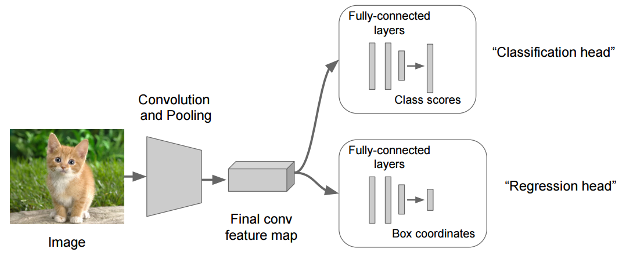
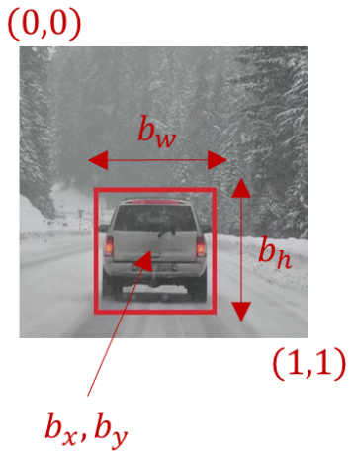



Image Localization & Detection Localization
Receptive field of the network
Alternative: Let the network predict the Class, the box location coordinates and box hight & width all at once!
Image Classification
Image Localization
Label of our Class
Bounding Box (Hight)
Bounding Box (Width)
You could also split the tasks to multiple networks!
$$y_{Class}= p_{c}$$
$y_{Loc}= p_{c}$ $b_{x}$ $b_{y}$ $b_{h}{ b}_{w}$
e.g. Target Vector:
Class = 1 (Car)
no Class = 0 (Backround)
Bounding Box (x-Coordinate)
Bounding Box (y-Coordinate)

Slide 5


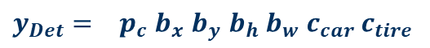
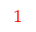
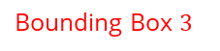

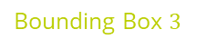

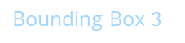
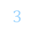
Image Localization & Detection Detection
Receptive field of the network
It is also possible to detect multiple classes and multiple objects at once!
Class Probability Car
$y_{Loc}= p_{c}$ $b_{x}$ $b_{y}$ $b_{h}{ b}_{w}$
$$3$$
$y_{Det}= p_{c}$ $b_{x}$ $b_{y}$ $b_{h}{ b}_{w}$ $c_{car}{ c}_{tire}$
Bounding Box $3$
$$1$$
$$2$$
${ p}_{c}$ $b_{x}$ $b_{y}$ $b_{h}{ b}_{w}$ $c_{car}{ c}_{tire}$
Bounding Box $3$
${ p}_{c}$ $b_{x}$ $b_{y}$ $b_{h}{ b}_{w}$ $c_{car}{ c}_{tire}$
Bounding Box $3$
Class Probability Tire
Downside: SLOW! Convolution over the whole image and optimization for so many output variabels at once is computationally intensive because we always slide over the whole image.

Slide 6
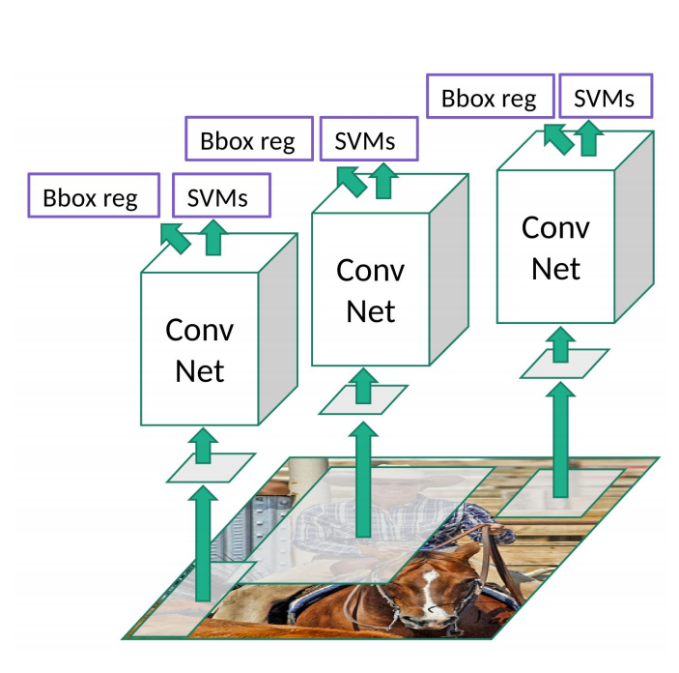
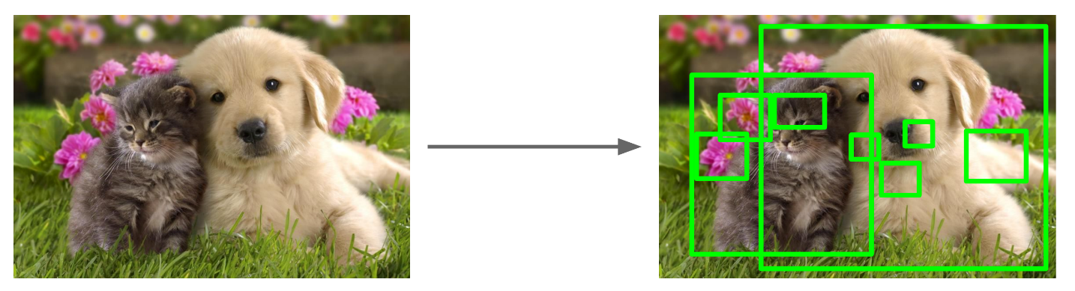
R-CNN („Region“ CNN)
Idea: Use a fast algorithm from computer vision (Selective Search) for bounding box proposals and run the classification and box regression on those (much smaller) Region of Interest (ROI) proposals.
Selective Search gives 2,000 region proposals in a few seconds
Its still computationally expensive. Each proposal runs independently, which means 3 ROI = 3 different Networks to optimize. The ROI proposals are not being learned.
All the features also dumped to disk so it takes a lot of space. Training is also super-slow and at inference is also very slow (47s per image for example).
Inference: Using a trained model to do the trained task (= forward pass only)

Slide 7
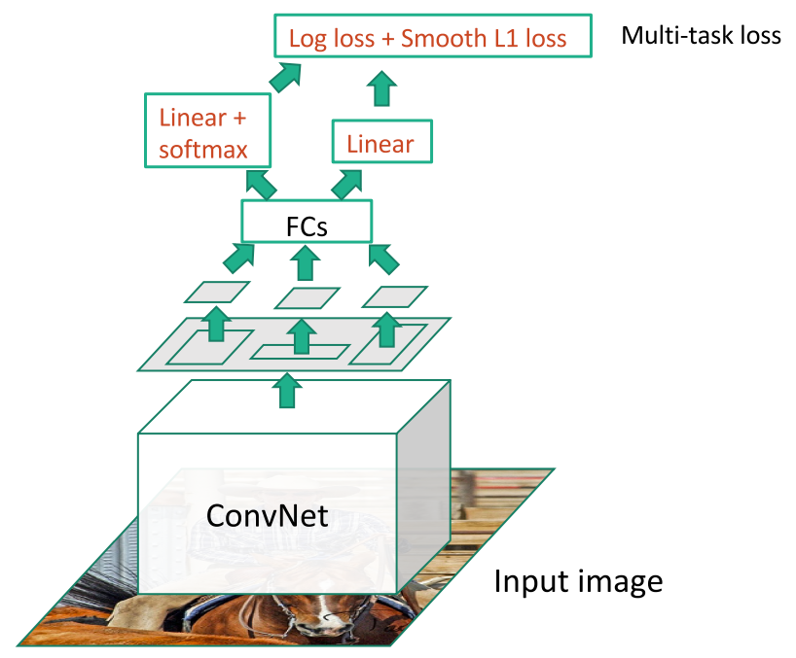
FAST R-CNN (Fast Region CNN)
R-CNN
optimize only one network instant of 3
FAST R-CNN
Run the whole image through one CNN to extract feature maps and extract ROI from there
Fast R-CNN 10x faster to train and inference less than a second per image but still not learning the ROI!

Slide 8
YOLO - You Only Look Once The king of inference speed
0.01
0.86
0.99
0.99
0.90
Divide picture into grid (in reality the grid is much finer!)
In every grid cell run multiple the ROI predictions at once using LeNet inspired network instead of Selective Search
Use non maximum suppression for each bounding box

Slide 9

YOLO - You Only Look Once The king of inference speed

